Slide 1
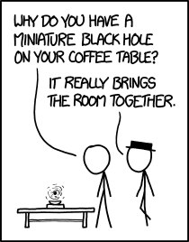
Paper Doodle & Presentation
ASBE fall 2025 – Onno Pols & Lieke van Son
source: xkcd

Slide 2
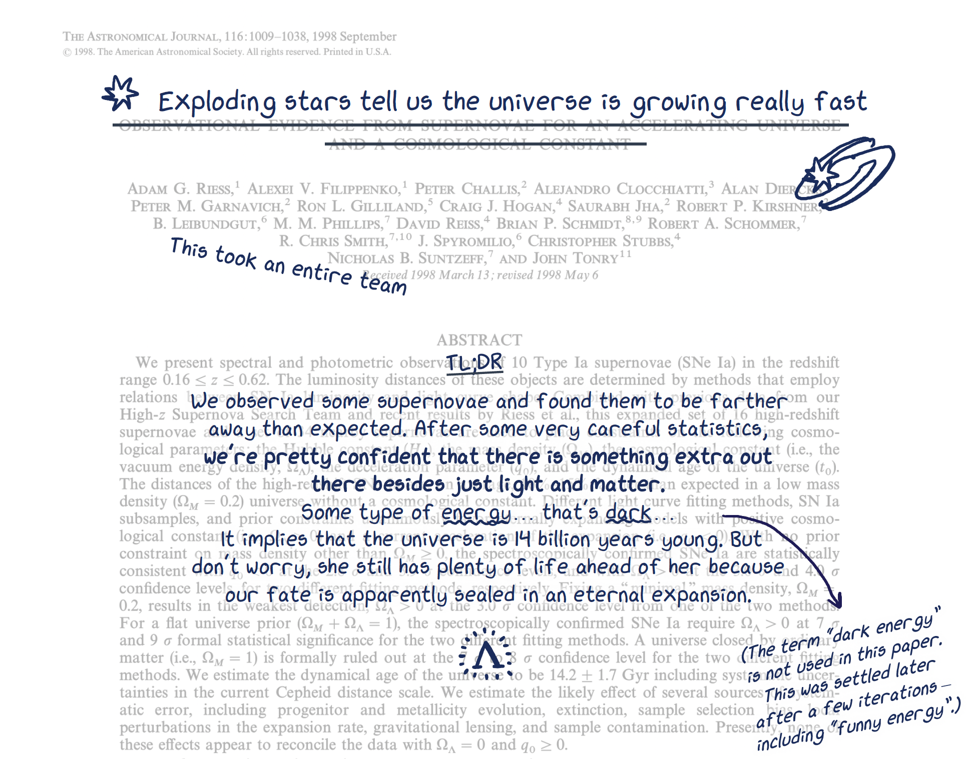
What is a paper doodle?
In the second half of the course, each student is asked to summarise a paper into a "doodle version", and present the result to the rest of the class.
See example here:
https://pubs.aip.org/physicstoday/online/42701/Translating-scientific-papers-for-the-public
- Credit to inventor Claire Lamman
The goal is for you to summarize paragraphs in a way that captures the bigger picture + provides helpful imagery
Notes:
We are also experimenting with this ☺
Open and scroll through the example ppt
Show xkcd (for those who don’t know of it)

Slide 3
Timeline/ Deadlines
-- Keep an eye out on Brightspace
Tuesday November 4th: → submit your chosen paper trough Brightspace for approval
Monday December 1st (17:00) → hand in final version of your paper doodle
Tuesday December 2nd (15:30-17:30) Paper presentations: 15 min pp

Slide 4
Grading
Both the paper doodle and your presentation count towards your final grade for this part of the course.
Together they make up 30% of the final grade.
Grading will be based on the following criteria:
How well you explain why you picked this paper, and why it is relevant.
How well you explain the main result(s) and conclusion(s) of the paper (keeping in mind the background knowledge of your fellow students),
How well you explain the connection of these results to what we learned during the course.
If you have successfully managed to distil your paper into a doodle version: extra points for creativity (artistic or otherwise).

Slide 5
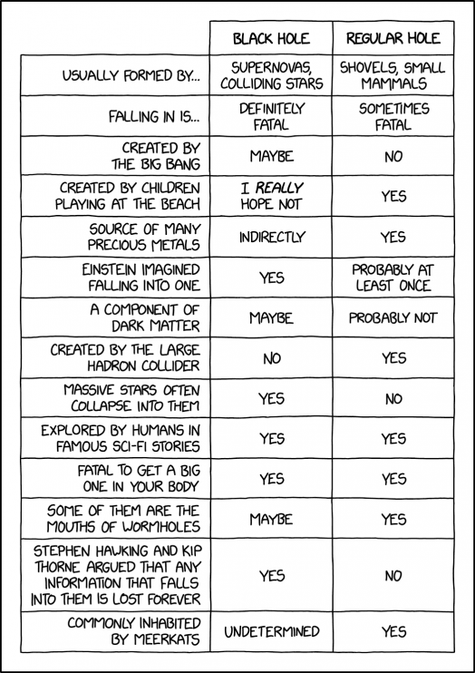
Potential subjects
Note that the topic of your presentation should be different from the topic your MESA case study.
Evolution of the first stars (population III)
Evolution of super-AGB stars
Formation of black holes in stellar core collapse
Testing stellar evolution theory using binary stars
Effects of rotation on the evolution of massive stars
Effects of binary evolution on stellar rotation
Properties and evolution of contact binaries
Formation and evolution of blue stragglers
Binary progenitor evolution towards Type Ia supernovae
Progenitor evolution of Type Ib/Ic supernovae
Progenitor evolution of gamma-ray bursts
Progenitor evolution of binary black hole mergers

Slide 6
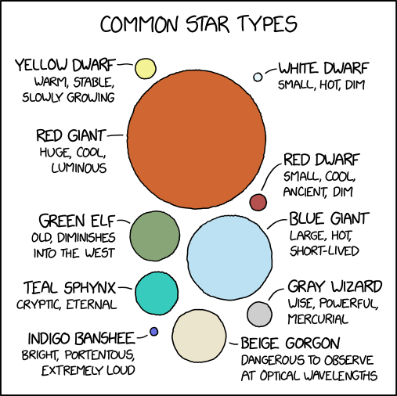

Bonus points for being creative
(artistic or otherwise).
The most important attributes of a vector in 3-space are {location, location, location}! - XKCD
Note, it pays off later to become a ppt or keynote master!
source: xkcd
Actual drawing skills are not required

Slide 7
Required Tools
Mostly Power point
Brightspace > Table of Content > Student presentations
You will find the paper-summary-template.ppt
You can use different tools to create/ import doodles
Easiest if you have a tablet that supports a PowerPoint app (like iPad), then you can directly use ppt under ‘Draw’
Alternatively you can doodle with pen & paper and use a photo to vector converter e.g., Adobe Capture, vectorizer.ai, or use Inkscape (Trace Bitmap or Trace pixel art)
Notes:
→ Open and go over the paper-summary
Q: who here does not have ppt? (or key note or something similar? )

Slide 8
Polling time
Notes:
By show of hands:
How many of you have joined in on a journal club or group meeting before?
Have you ever had to present a paper during a journal club/course before?
How many of you have alreay started a master research project/think you know what you would like to do?

Slide 9
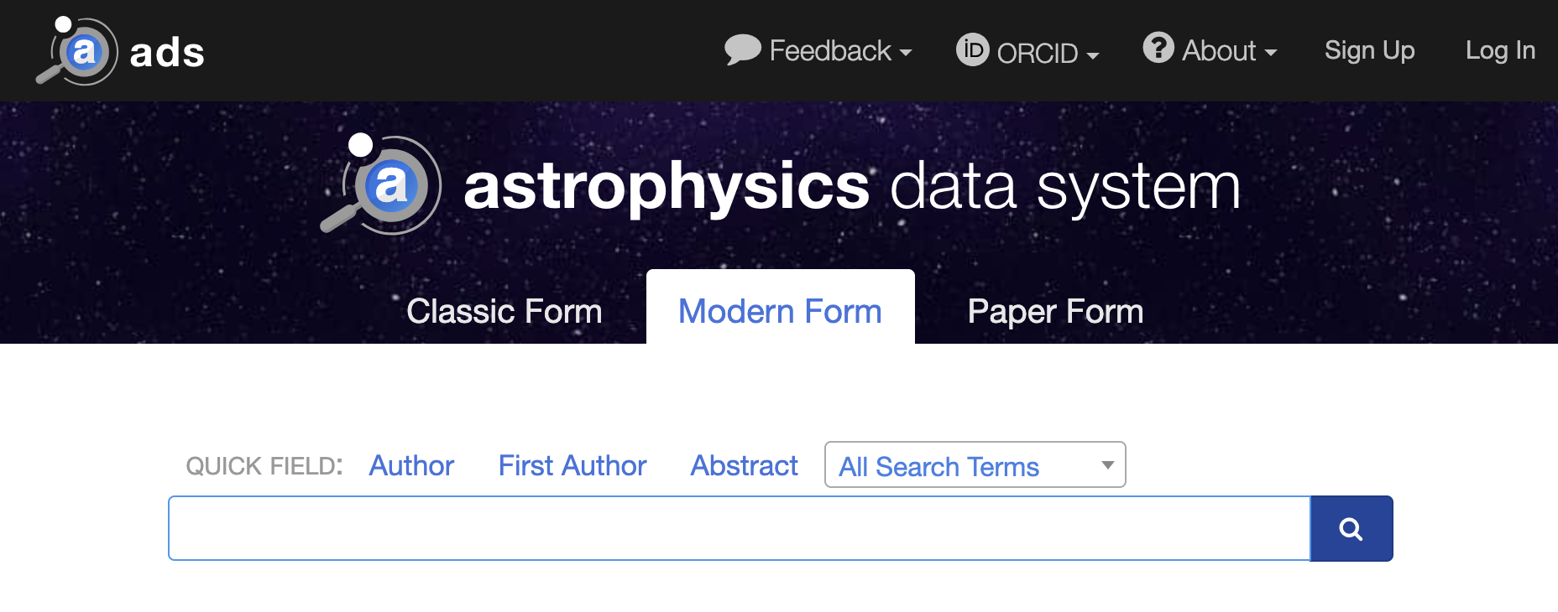

How to pick the right paper
Note that we will care why you picked a paper
“because it was short”, or “because chat GPT said so” are not good reasons.
Try to understand why a particular paper has contributed to the field
a good (but definitely not the only!) metric to quantify the impact of a paper is the citation count
Use the ADS: https://ui.adsabs.harvard.edu/
& ArXiv: https://arxiv.org/archive/astro-ph
If you have trouble accessing papers, try again from the EDU network or check the arXiv!
Notes:
Live demo Go to ADS search> author:"Oppenheimer" author:"Volkoff"

Slide 10
How to pick the right paper (cont.)
“Science” and “Nature” papers are disfavoured: they have an odd format that forces all the main matter & figures to the appendix.
You should skim multiple papers before making your pick:
Search inside review papers on your topic. common review journals -Reviews of Modern Physics (APS Journals) -- bibstem:"RvMP" - Annual Review of Astronomy and Astrophysics (ARAA) – bibstem:”ARA&A” - Living Reviews in Relativity (Springer) – bibstem:”LRR”
(e.g., bibstem:"ARA&A" title:"Massive star”)
Read several abstracts of interesting event or discovery papers
What do other people cite this paper for? (use ‘citations’ link in ADS)
Notes:
Live demo Go to ADS search>
Or
bibstem:"ARA&A" title:"Massive star”

Slide 11
What to ask yourself while reading a paper
Abstract: What’s the main result?
Introduction: Why should we care?
Methods: What was actually done? Does this support the results?
Results: What are the main figures? Can you identify the money plot?
Discussion/Conclusion: What does it mean?
Notes:
Polling:
Who here is already doing a research project?

Slide 12
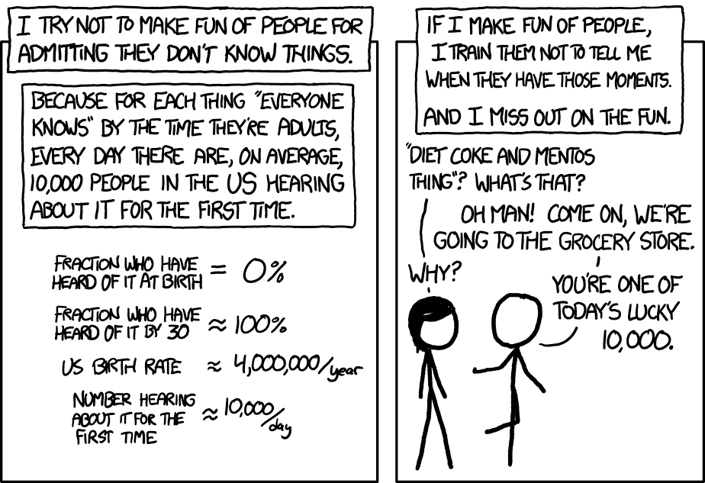
No one knows everything…
Note that papers are written for experts by experts.
It is perfectly normal to have to look up some terms!
source - xkcd

Slide 13

Time for some practice!
Pair up in teams of 2 or 3
Pick a paper from the ArXiv (https://arxiv.org/list/astro-ph/new) purely based on the title! preferably on “Solar and Stellar Astrophysics” or “High Energy Astrophysical Phenomena”, but feel free to pick a title both of you like
Let’s take 5 min to do this

Slide 14
What to ask yourself while reading a paper
Abstract: What’s the main result?
Introduction: Why should we care?
Methods: What was actually done?
Results: What are the main figures? Can you identify the money plot?
Discussion/Conclusion: What does it mean?
Notes:
Polling:
Who here is already doing a research project?

Slide 15
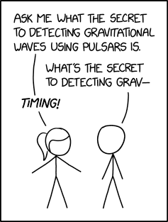
Time for some practice!
Now you both open the same paper:
One of you tries to summarize the main findings based on the conclusion section
The other person tries to summarize the paper looking only at the Figures
Take 5 minutes…

Slide 16



Further handy tools
You will have to read a lot of paper if you stay on the academic path
Now is the time to experiment with different Citation managers most common are
Zotero
Mendeley
EndNote
New AI powered research tools, like Elicit, Semantic Scholar, Research Rabbit etc. etc. etc. (beware, they might be paid)
Always check the original reference! LLM’s are designed to hallucinate
Notes:
Note there are new AI powered research tools, like Elicit, Semantic Scholar, Research Rabbit etc. etc. many many others (beware, they might be paid)
Always check the original reference! LLM’s are designed to hallucinate

Slide 17
Questions?

Slide 18
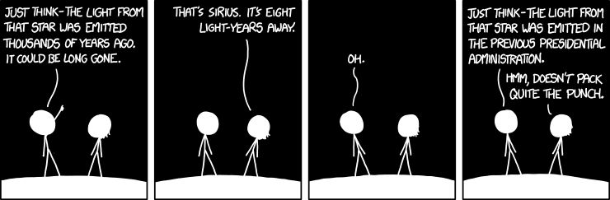

Slide 19
